Slide 1
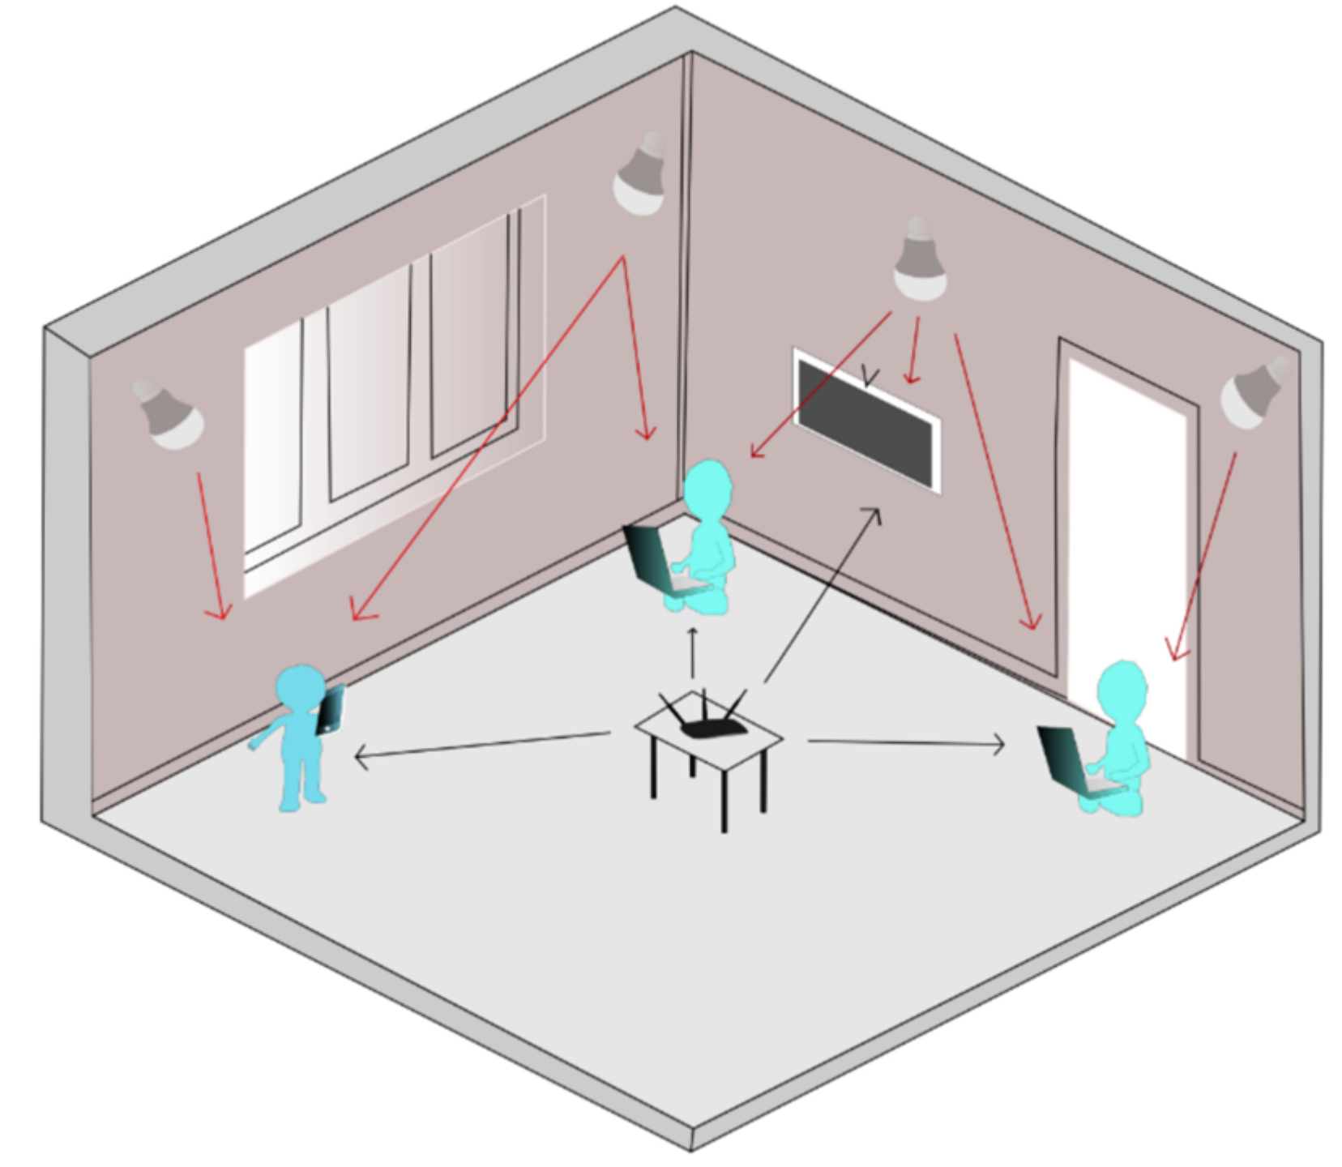
Network Selection in Hybrid Visible Light Communication-Radiofrequency System
Lisandra Bravo Alvarez, Jose Núnez Kasaneva, Samuel Montejo Sánchez, Lien Rodríguez López, and Gabriel Saavedra

Slide 2
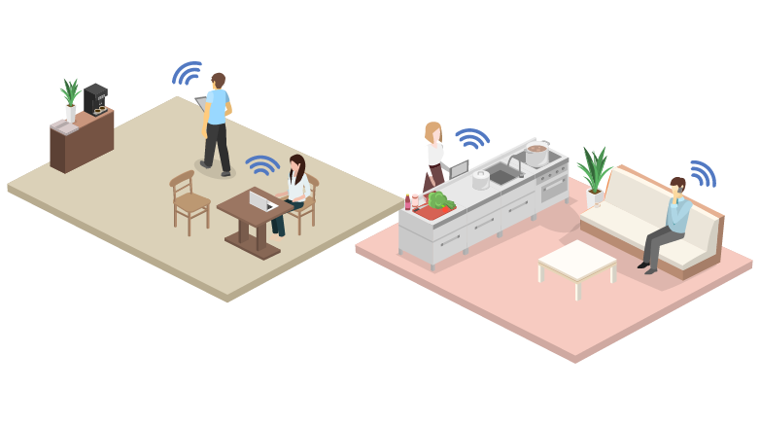
Network Selection in Hybrid Visible Light Communication-Radiofrequency System

Slide 3
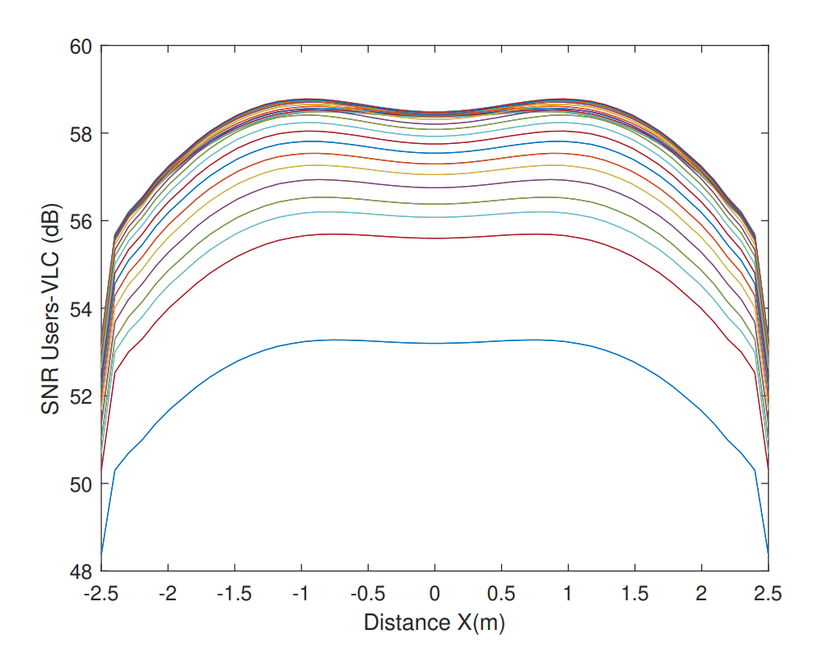
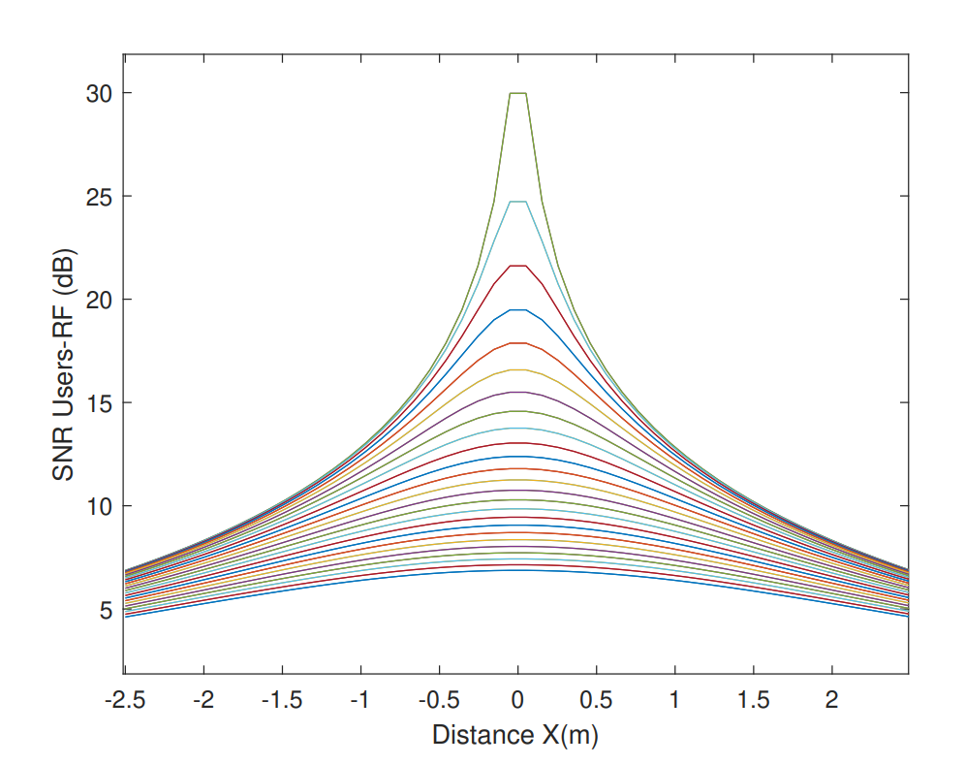
PERFORMANCE EVALUATION
SNR Vs Distance from the user to the AP
in the VLC network
SNR vs Distance from the user to the AP
in the RF network

