Slide 1
Paper Title

Slide 2
Agenda
Topic 1
Topic 2
…
Topic n

Slide 4
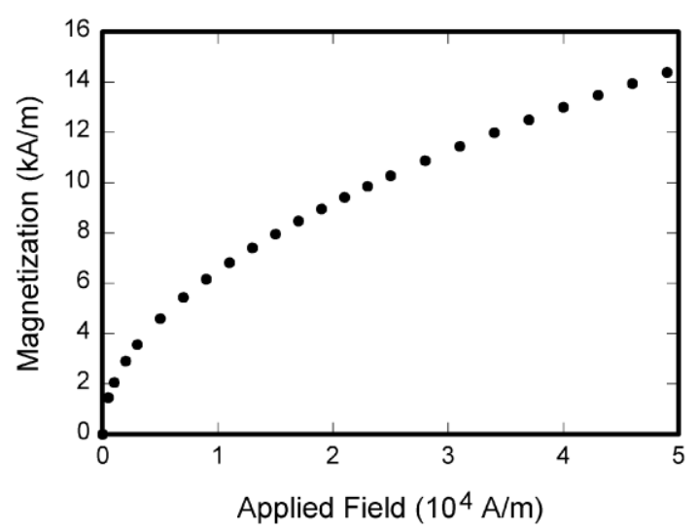
Fig. 2 Magnetization as a function of …..

